Slide 1
Sources of Data
Data is everywhere
Social media : Facebook, Instagram, Twitter, LinkedIn
Retail Transaction : online payments
E-commerce : Amazon, eBay, Flipkart, Alibaba
Cloud : Cloud platforms like AWS, Google Cloud
Web : Websites, blogs, forums, and online surveys
Social Network Profiles : User-created profiles on platforms like LinkedIn and Facebook
Network and in-stream monitoring technologies : Network traffic monitors

Slide 2




Slide 8


Slide 11



Slide 27






Slide 28


Slide 29


Slide 30


Slide 35


Slide 37


Slide 40


Slide 42


Slide 43
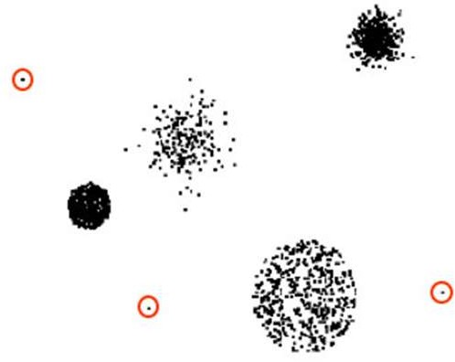

Slide 44
Noise in data refers to random errors or fluctuations that do not reflect the true underlying pattern in the data. These can arise due to various reasons such as data entry mistakes, or inconsistencies during data collection etc.

Slide 48



Slide 57
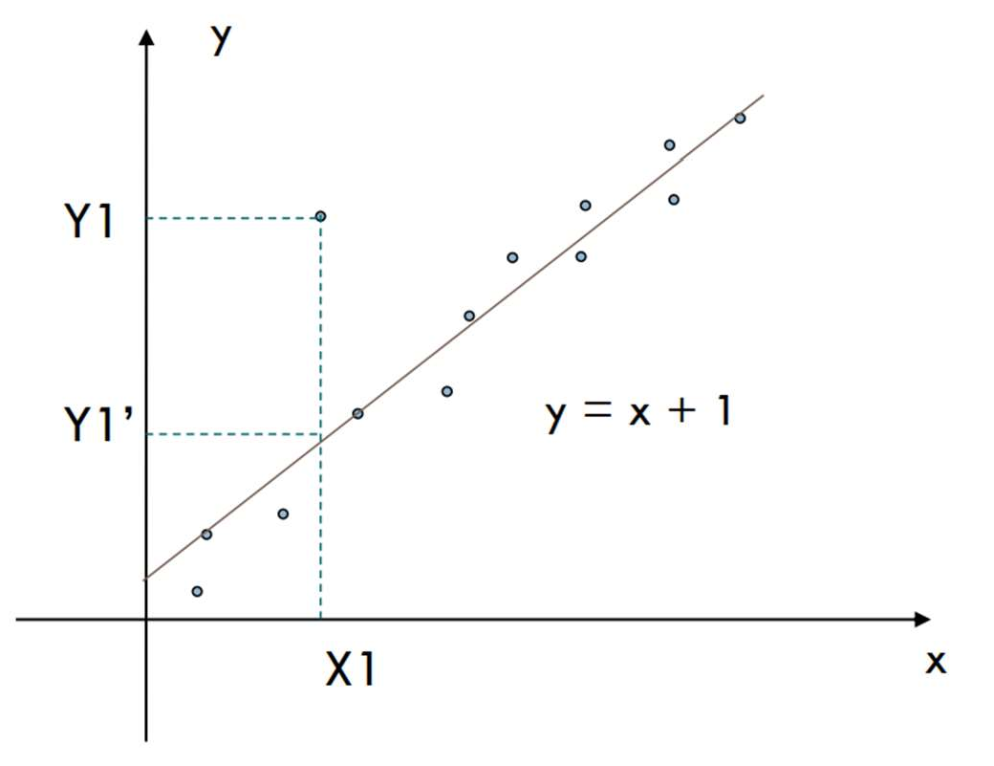

Slide 59


Slide 61


Slide 68





Slide 69


Slide 70


Slide 72


Slide 73


Slide 78


Slide 79
Steps for Decimal Scaling:
Find the maximum absolute value in the dataset.
Determine the scaling factor 10^{j}, where j is the smallest integer such that: 10^{j} ≥ max⁡(∣X∣)
Divide each value in the dataset by 10^{j}.
Example:
Suppose we have the following dataset: [-987,1504,315,220], Maximum absolute value = 1504
The scaling factor 10^{j} should be 10⁴ = 10000 will scale the maximum value to less than 1.
Scale the data by dividing each value by 10000:
X_{scaled}=[-987/10000,1504/10000,315/10000,2201/0000]=[-0.0987,0.1504,0.0315,0.022]

Slide 80




Slide 82


Slide 83


Slide 84


Slide 86
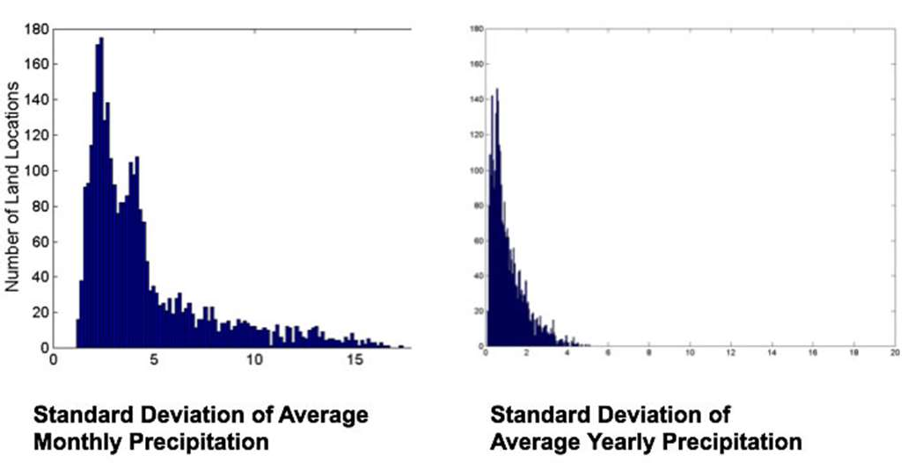


Slide 87




Slide 88
